Slide 1
Poverty and American National Priorities
William Julius Wilson
Harvard University

Slide 2
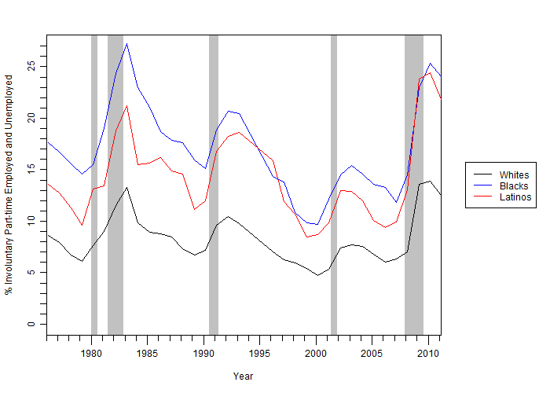
Figure 1: Rates of Part-time Involuntary Employment and Unemployment Among Male Workers 16+ by Race and Ethnicity
Source: Authors’ tabulations based on Bureau of Labor Statistics’ Current Population Survey March Supplement
Shaded areas indicate recession periods

Slide 3
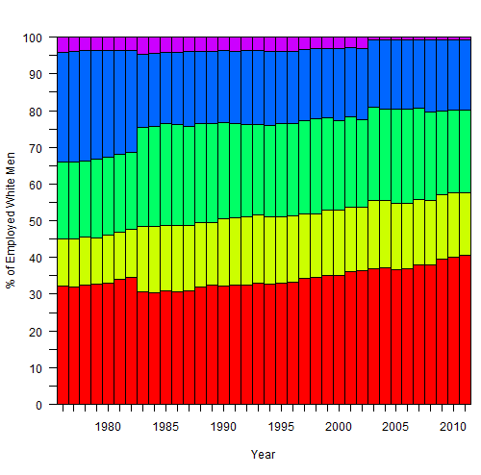
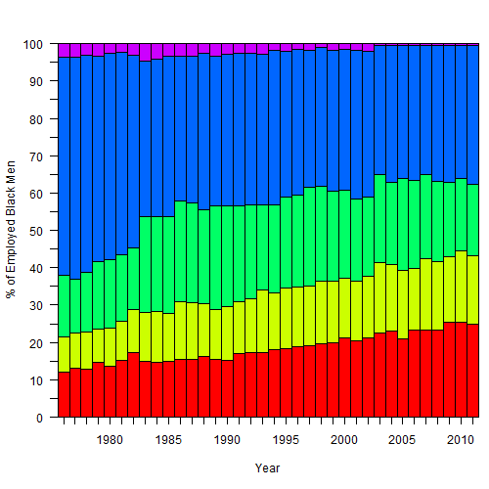
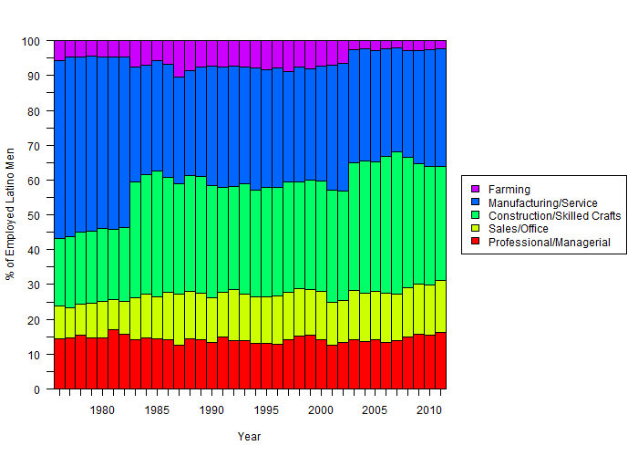
Figure 2: Occupational Clustering Among Male Workers 16+ by Race and Ethnicity
Source: Authors’ tabulations based on Bureau of Labor Statistics’ Current
Population Survey March Supplement

Slide 4
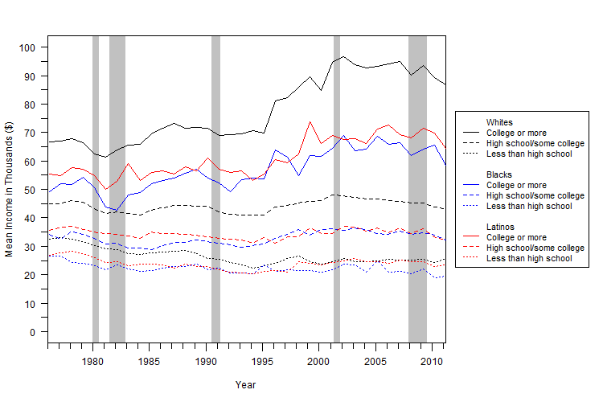
Figure 3: Real Mean Income Among Male Workers 16+ by Educational Attainment and Race and Ethnicity
Source: Authors’ tabulations based on Bureau of Labor Statistics’ Current Population Survey March Supplement
Shaded areas indicate recession periods

