Slide 1
Evaluating the Empirical Performance of Sandwich Learned Bloom Filter and Adaptive Learned Bloom Filter
Yinzhe (Peter) Ma
advised by Professor Tassarotti

Slide 2
Agenda
Project Introduction
Intro to Standard Bloom Filter
Intro to Sandwiched Learned Bloom Filter + empirical results discussion
Intro to Adaptive Learned Bloom Filter + empirical results discussion
Comparison of Data Structures
Conclusion

Slide 3
Project Introduction
Problem
Standard Bloom Filter faces tradeoff between correctness and memory efficiency → False Positive Rate
Exploration
Sandwiched Learned Bloom Filter + Adaptive Learned Bloom Filter
Goal
Validate these two newly proposed data structures from an empirical perspective
Explore necessary implementation methods of these two proposed data structures
Background: A Bloom Filter is a set data structure that uses independent hash functions to store a set of elements; when querying elements from the same universe, a Bloom Filter gives out possible false positives and no false negatives.

Slide 4
Standard Bloom Filter
An empty array A
0
0
0
0
0
0
0
0
0
0
0
0
0
0
0
0
...
m
A set of data S
1 | 2 | 3 | 4 | 5 | 6 | 7 | 8 | 9 | 10 | ... | n
A group of k independent, universal hash functions H
Hash Function 1
Hash Function 2
Array A
1
0
0
0
0
0
0
0
0
1
0
0
0
1
0
0
0
0
False Positive: two values from S are being hashed to the same bit in A

Slide 5
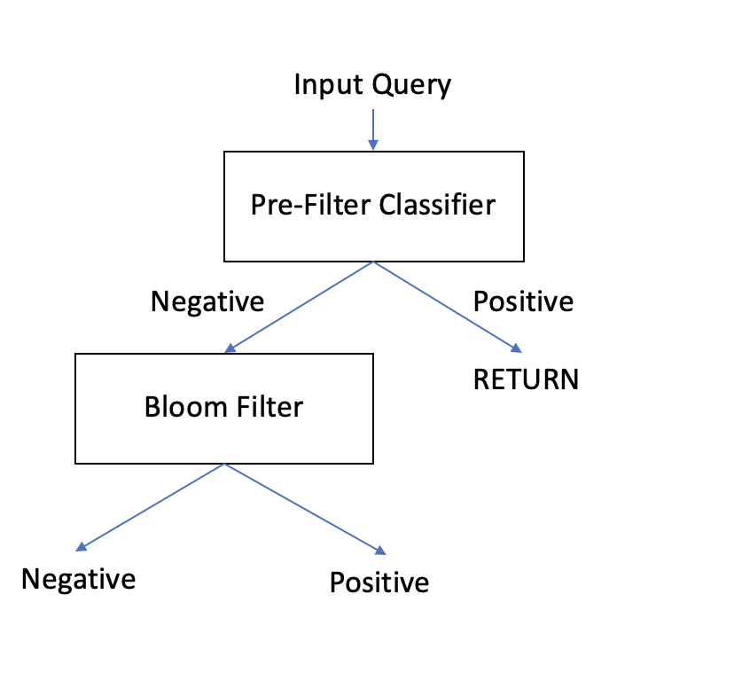
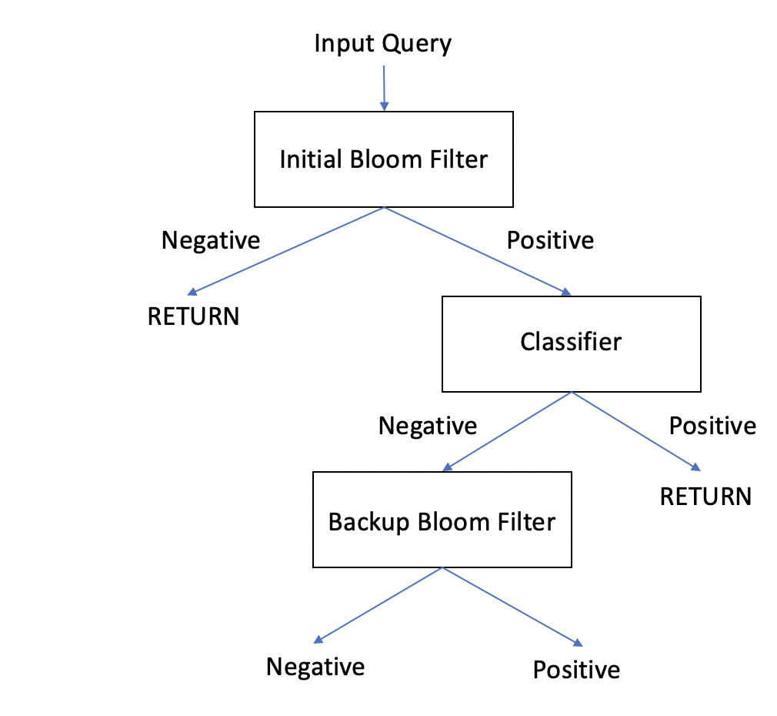
Sandwiched Learned Bloom Filter
Motivation
To explore how Machine Learning Algorithms can help solve the trade off that the standard Bloom Filter faces → Correctness vs. Memory
Sandwiched Learned Bloom Filter
Learned Bloom Filter

Slide 6
Sandwiched Learned Bloom Filter -- Details
False Positive rate of the structure
False positive rate of the backup filter
False Positive Rate Analysis
False positive rate of Learned Function
False positive rate of Initial Filter
Take derivative to find the minimum False Positive Rate
Memory Allocation Analysis
Optimal memory allocated to the backup filter
Optimal # of bit per element for the backup filter
False Negative rate of the Learned Function
False Positive rate of the Learned Function

Slide 7
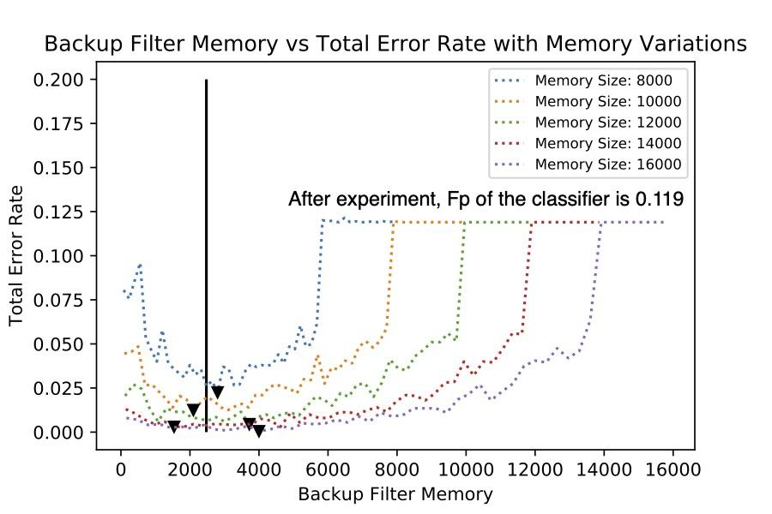
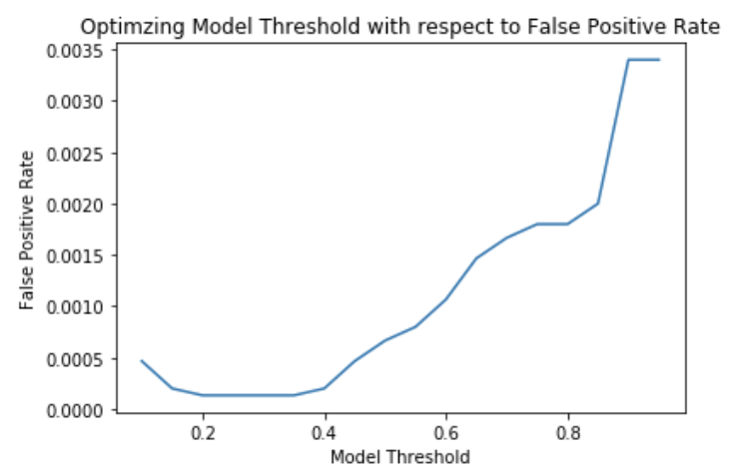
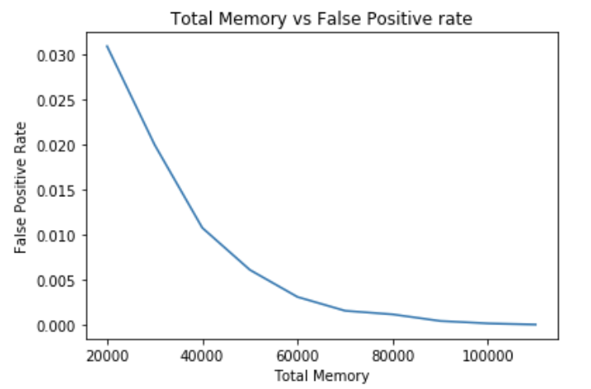
Sandwiched Learned Bloom Filter -- Experiments
✅ Our empirical experiment validates the theoretical optimal memory allocation that once the backup filter reaches a fixed threshold, all other memory should be given to the initial filter

Slide 8
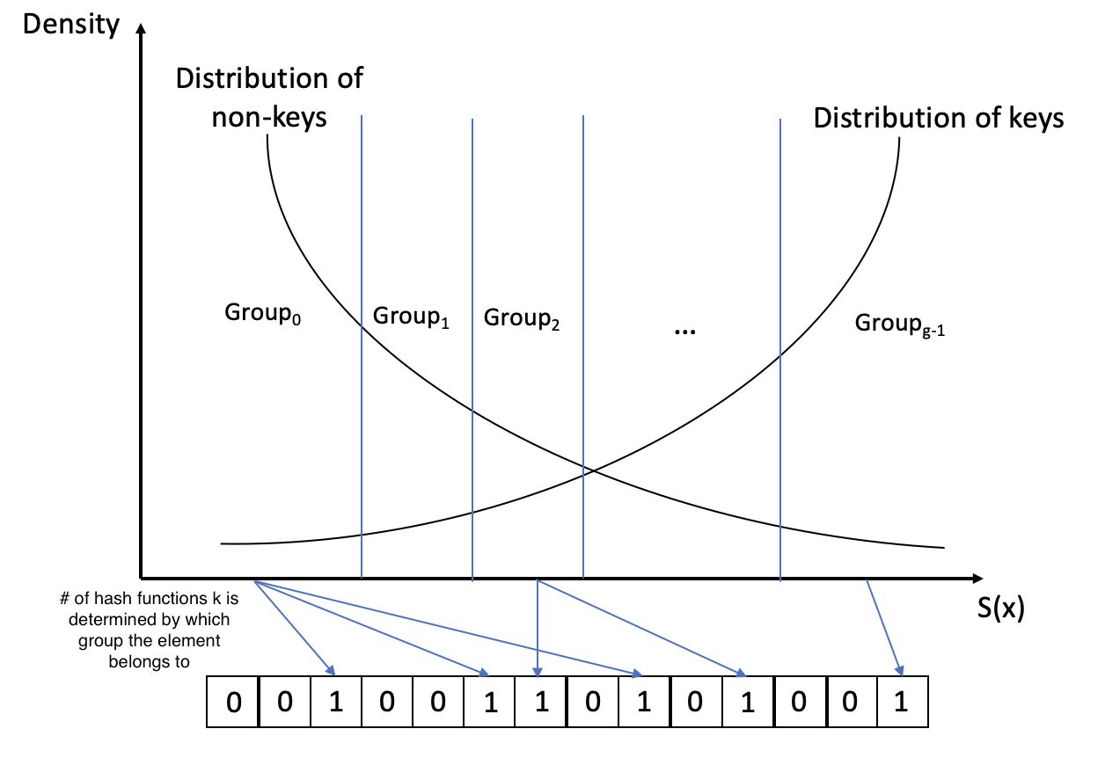
Adaptive Learned Bloom Filter
Motivation
Information provided by the ML algorithm is wasted
Dependency on the query data set staying within the same universe is too strong
Sandwiched Structure
Initial Filter would be a standard Bloom Filter
# of hash functions used for the backup filter is determined by its group assignment (the estimation given by the learned function)
Higher the score, the fewer the hash functions used
Est. given by the ML function
Notes:
Explain motivation a bit more

Slide 9
Adaptive Learned Bloom Filter -- Details
False Positive Rate of Group j
K is the # of hash functions used in Group j
A total of g groups
False Positive Rate of the data structure
Probability of an arbitrary query falling in Group j
Hyper-
parameters
# of groups g
Maximum number of hash functions used
C, where c=

Slide 10
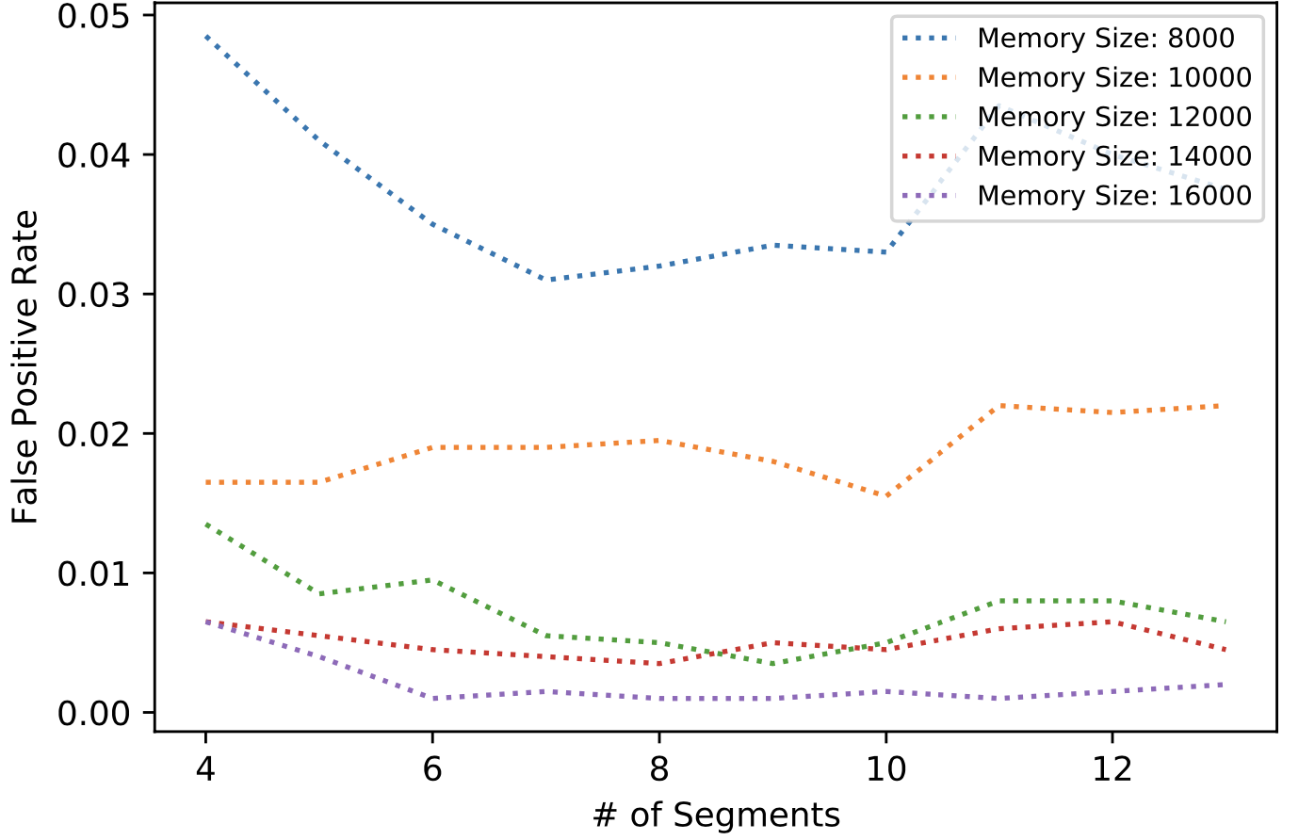
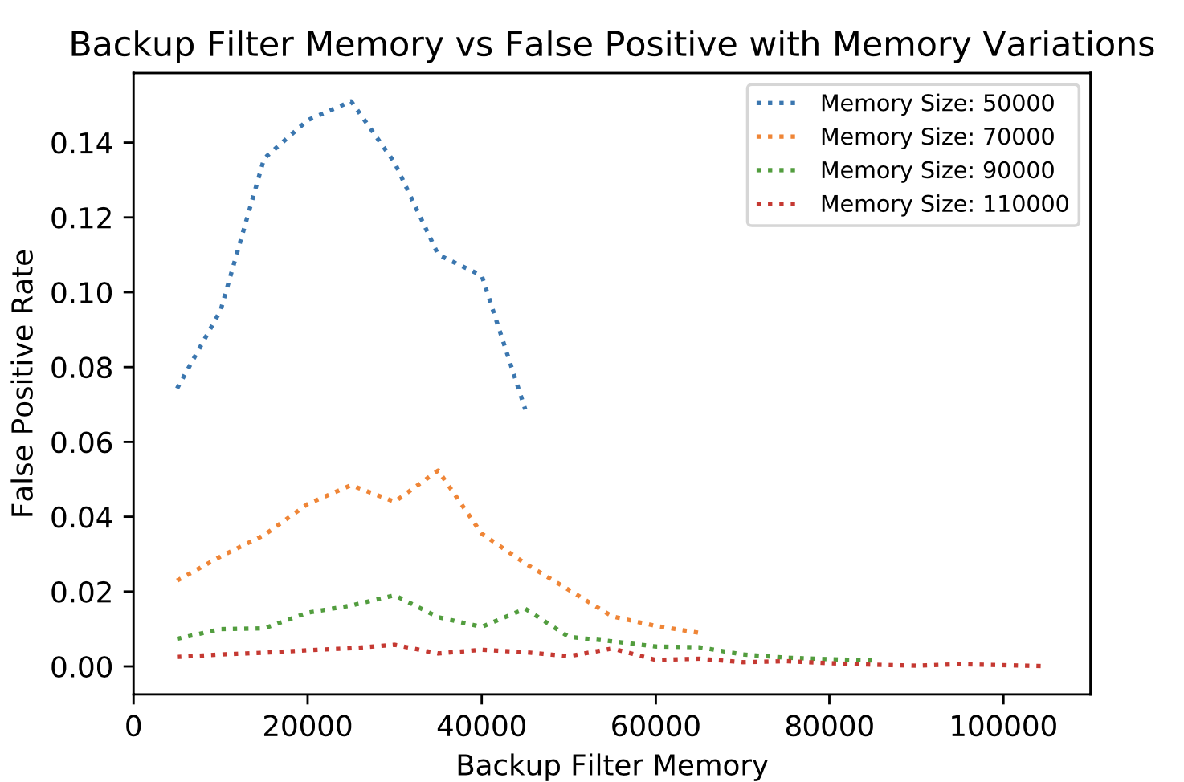
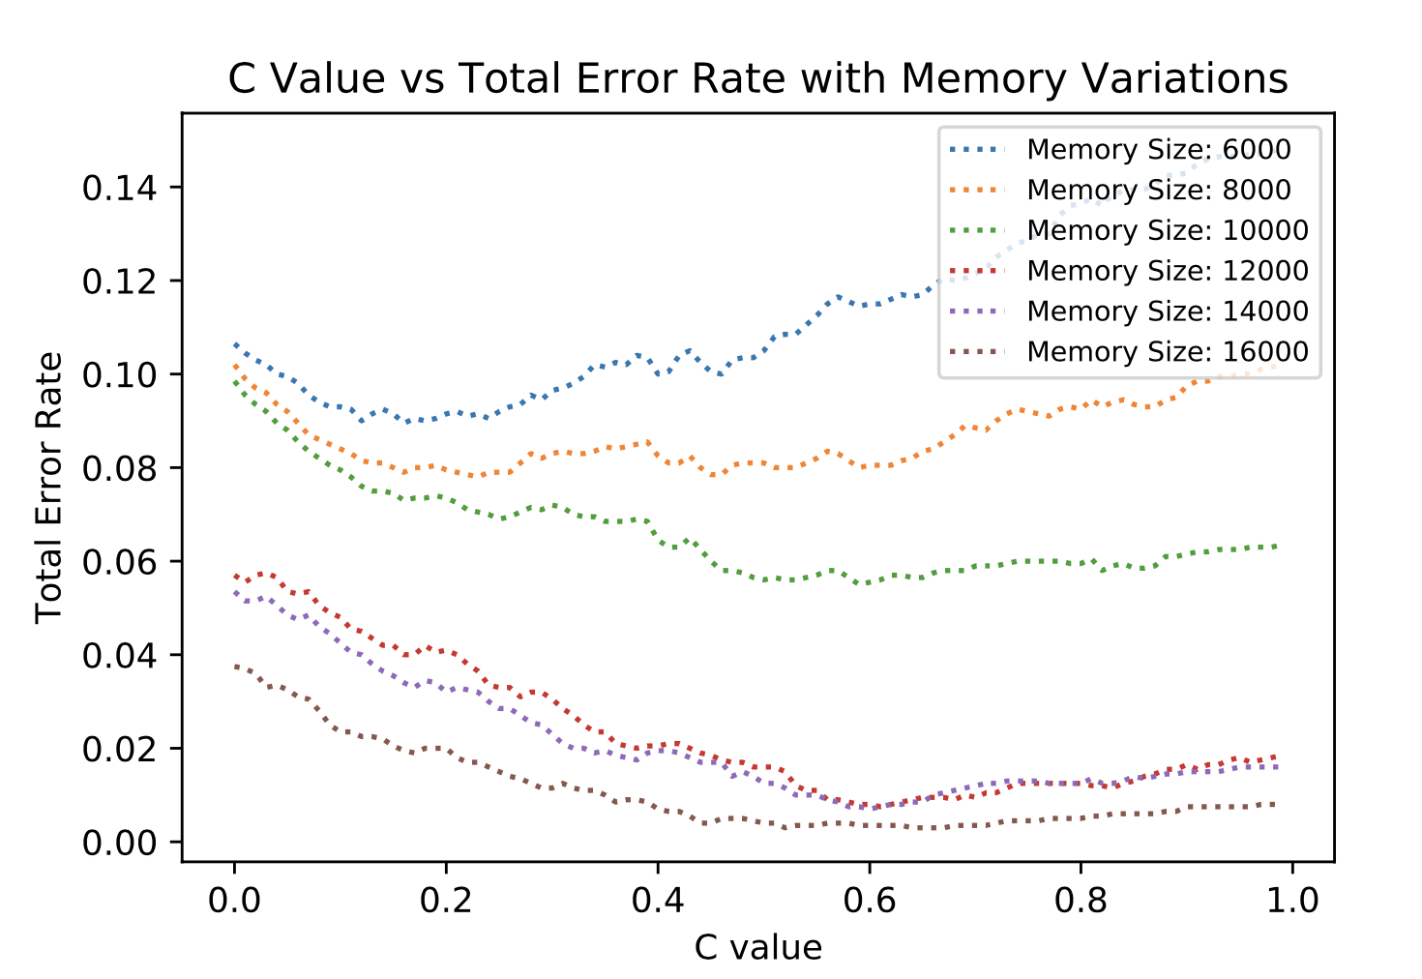
Adaptive Learned Bloom Filter -- Experiments
❓With 10 segments and c=0.5, it seems that we need to allocate as much memory to the backup filter as possible. However, the experiments we have done so far are not enough for us to be certain about such observation → Non-sandwiched Structure

Slide 11
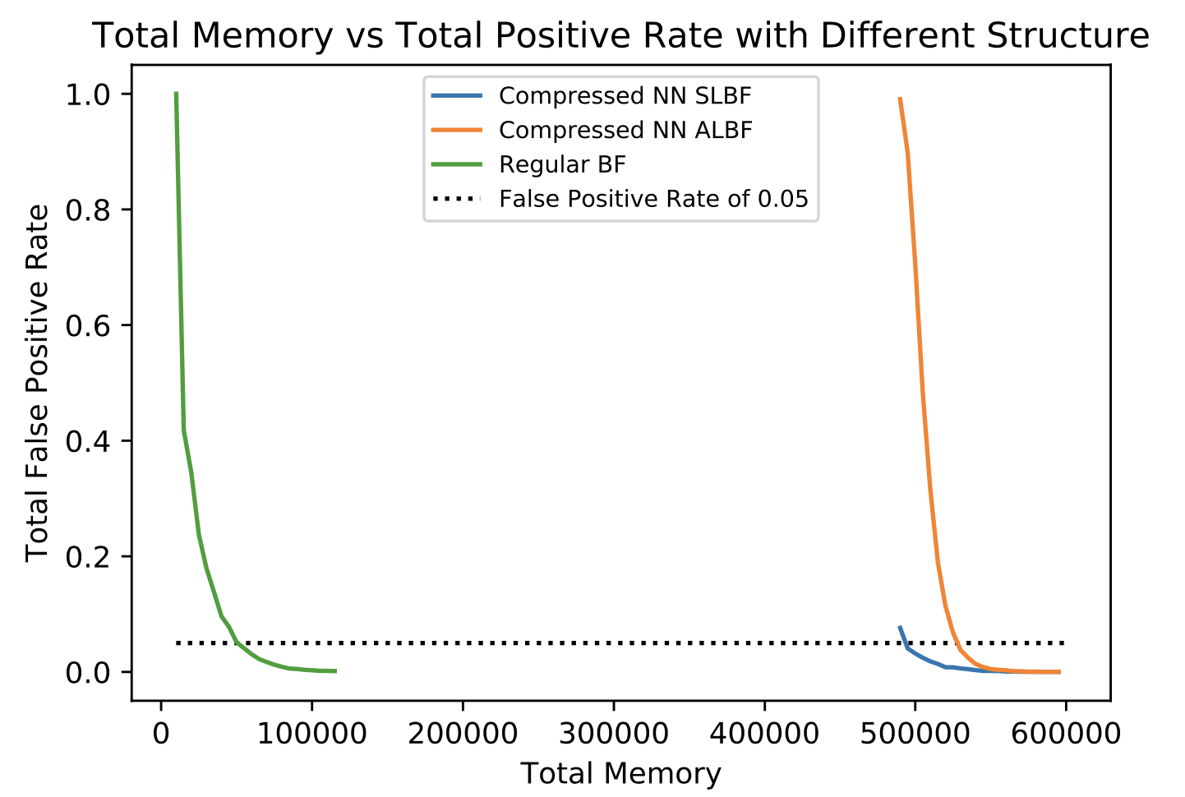
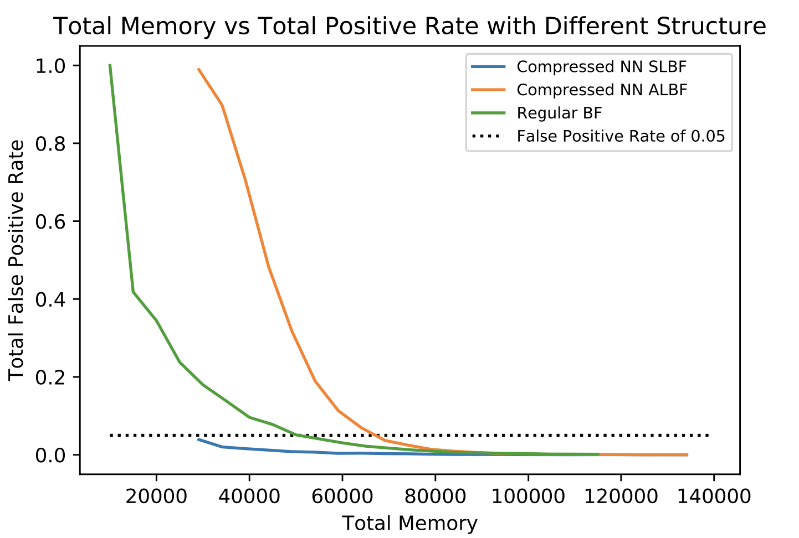
Comparison of Data Structures
Initial Size (Without compression)
Final Size (With compression)
Pruning
Weight Clustering
Quantization
Notes:
Add a bit more background

Slide 12
Conclusion
✅
Sandwich Learned Bloom Filter is more efficient on this example than the standard bloom filter especially when the memory size is below 3.5 bits per element after model compression
❓
We did not find Adaptive Learned Bloom Filter to be better than the other two data structures, but this could be due to its complicated tuning process

Slide 13
Reference
[1] Michael Mitzenmacher. 2018. A Model for Learned Bloom Filters and Optimiz- ing by Sandwiching. In Advances in Neural Information Processing Systems 31, S. Bengio, H. Wallach, H. Larochelle, K. Grauman, N. Cesa-Bianchi, and R. Gar- nett (Eds.). Curran Associates, Inc., 464–473.
[2] Zhenwei Dai and Anshumali Shrivastava. 2019. Adaptive Learned Bloom Filter (Ada-BF): Efficient Utilization of the Classifier. arXiv preprint arXiv:1910.09131 (2019).
[3] T. Kraska, A. Beutel, E. H. Chi, J. Dean, and N. Polyzotis. The Case for Learned Index Structures. https://arxiv.org/abs/1712.01208, 2017.

