Slide 1
Assisting Federated Learning with Vehicular Clouds
Yicheng Shen
Supervisor: Prof. Lewis Tseng
May 1 2021

Slide 2
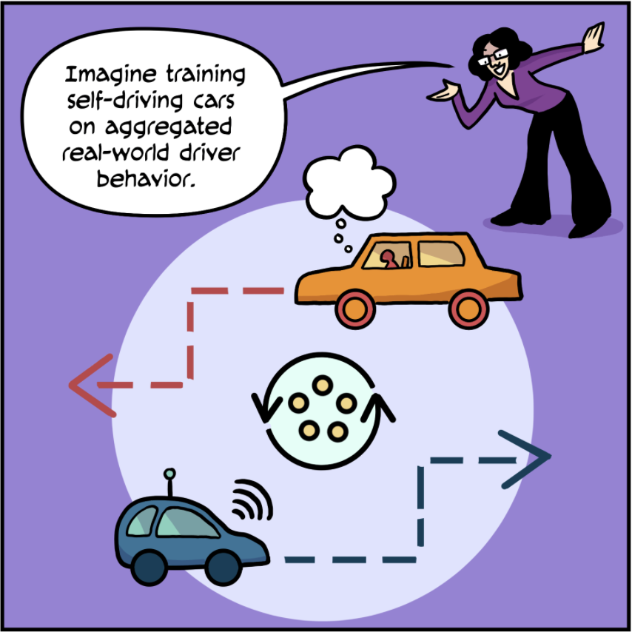
Background Knowledge
Federated Learning
  Using on-device data to train deep learning models
Vehicular Clouds
  Virtual edge servers formed by vehicles
https://federated.withgoogle.com

Slide 3
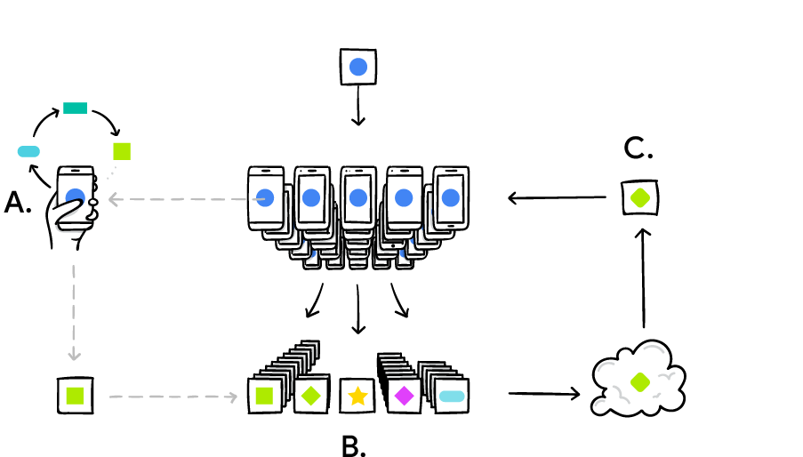
Why Federated Learning?
Different from traditional centralized ML
Decentralized design
Real-time training
Utilize local data → Privacy
Adoptions in various applications
  Gboard on Android, Scene understanding in AR, etc.
McMahan and Ramage, Google. (2017) https://ai.googleblog.com/2017/04/federated-learning-collaborative.html

Slide 4

Why Vehicular Clouds?
Vehicles as an emerging computational resource
Multiple nearby vehicles form a virtual edge server
Leverage on-board units
  Communication, storage, and computation

Slide 5
VC-SGD: Core Tasks
Integration of edge-based FL and VC
Customized simulator
  SUMO: simulate vehicle mobility
  MXNet: perform real ML training
Investigation of “data collection” problem
  FL using real-time location-specific data

Slide 6
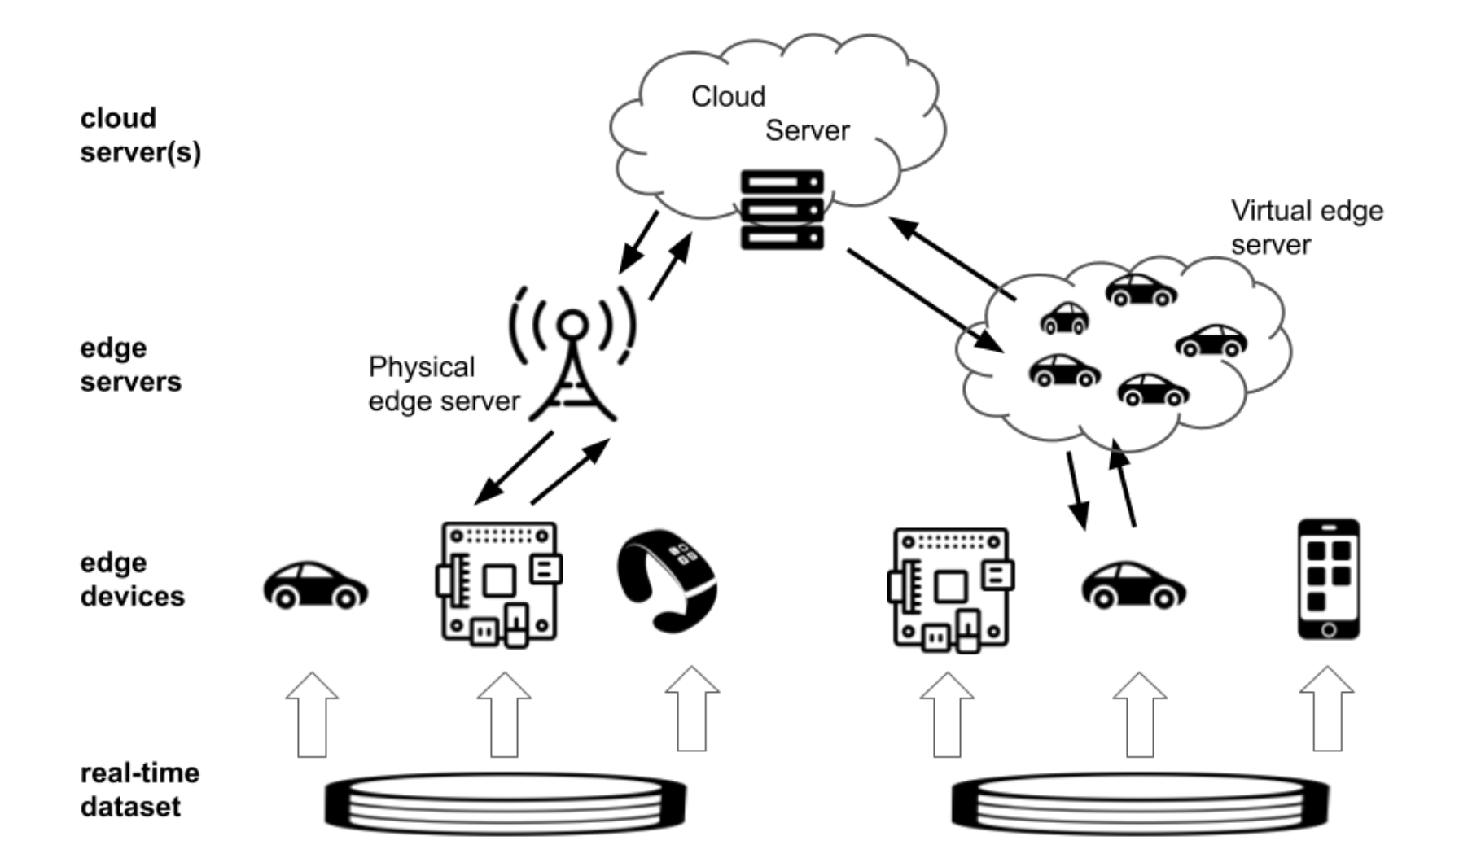
VC-SGD Architecture

Slide 7
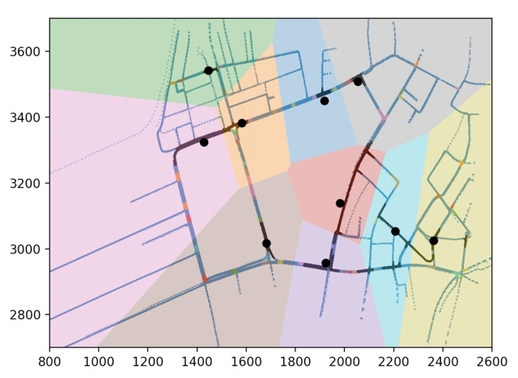

Real-time Location-Specific Data
Physical Roadside Unit
Virtual Vehicular Cloud

Slide 8
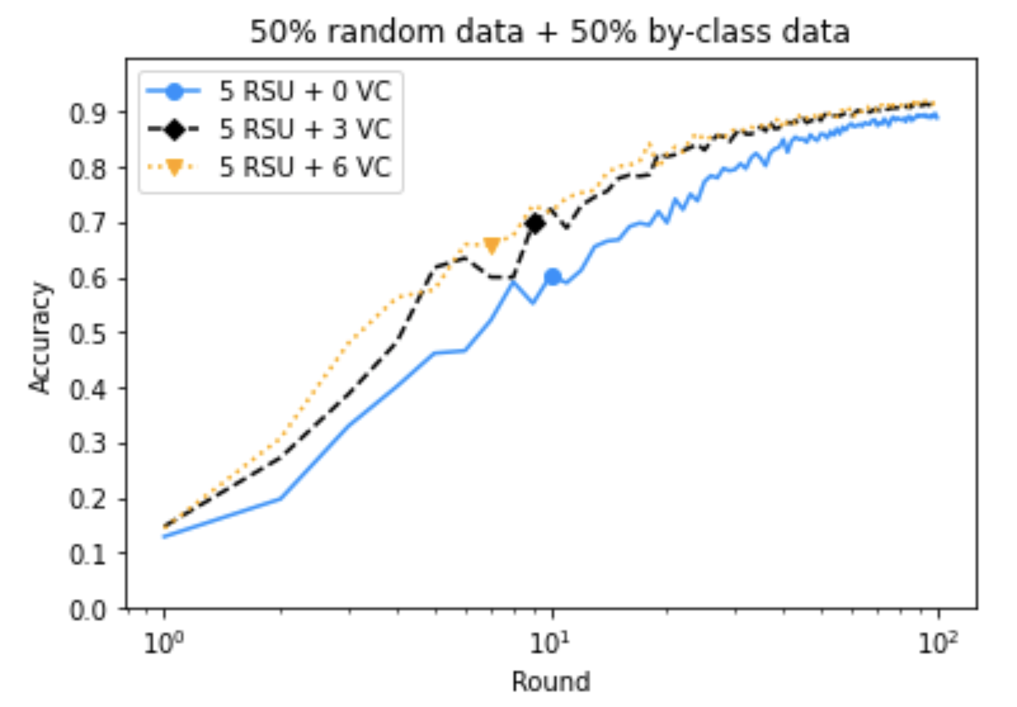
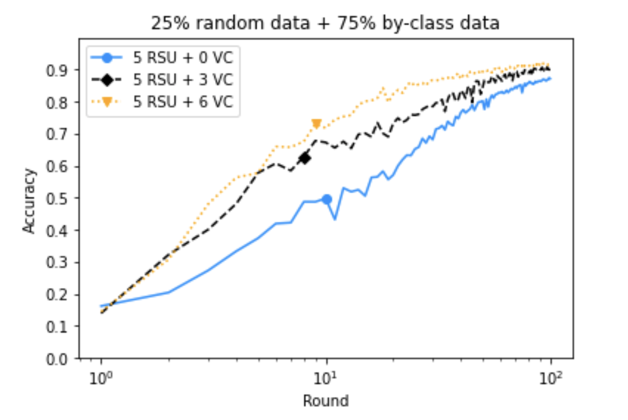
Experimental Results
More VCs → higher accuracy
VC-SGD has better performance with more location-specific data

Slide 9
Summary and Future Work
Summary
FL using real-time location-specific data
VC-SGD
Customized simulator
Future Work
Extensive evaluation
Advanced problems and integration with pervasive systems
Robustness

Slide 10
Special Acknowledgments
Anran Du
My research teammate
Prof. Lewis Tseng
Supervisor of my thesis

Slide 11
Thank You!

