Slide 1
Reliable Broadcast + Benchmark
Yingjian Wu
April 30th
Advisor: Prof. Lewis Tseng

Slide 2
Table of Contents
Accomplishment of My Honor Thesis
General Background
Algorithms
Benchmark tool
Benchmark Data

Slide 3
Core tasks I have completed
Design and implement new reliable broadcast algorithms that are more efficient in practical network systems, e.g., bandwidth efficiency.
Design an automatic and easy-to-use general benchmark system for distributed fault tolerant algorithms

Slide 4
BackGround Knowledge of Broadcast Systems
Network Model:
Asynchronous network
Reliable and Authenticated channels
Faulty Model:
Tolerates up to f number of faulty servers in the networks
Source can also be faulty

Slide 5
Property 1 (Non-faulty Broadcast Termination).
Non Faulty Source
m: message
r: rounds of the broadcast
reliable Broadcast(m,r)
(m,r)
(m,r)
(m,r)
(m,r)
Non-Faulty Server
Non-Faulty Server
Non-Faulty Server
Faulty Server
reliable accept(m,r)
reliable accept(m,r)
reliable accept(m,r)
Notes:
Property 1 (Non-faulty Broadcast Termination). If a non-faulty source 𝑠 with a message 𝑚 of index h performs Reliable-Broadcast(𝑚, h), then all non-faulty nodes will eventually Reliable-Accept(𝑠, 𝑚, h).

Slide 6
Property 2 (Validity)
m: message
r: rounds of the broadcast
Non Faulty Source
does not broadcast(m,r)
Non Faulty Server
Non Faulty Server
Faulty Server
Non Faulty Server
does not reliable accept(m,r)
does not reliable accept(m,r)
does not reliable accept(m,r)
Notes:
Property 2 (Validity). If a non-faulty source 𝑠 does not perform Reliable-Broadcast(𝑚, h) then no non-faulty node will ever perform Reliable-Accept(𝑠, 𝑚, h).

Slide 7
Property 3: Agreement
Non-Faulty
Server 1
Non-Faulty
Server 2
reliable Accept(m, r)
reliable Accept(m’, r)
m = m’
Notes:
Property 3 (Agreement). If a non-faulty node performs Reliable- Accept(𝑠, 𝑚, h) and another non-faulty node will eventually perform Reliable-Accept(𝑠,𝑚′,h) then 𝑚 =𝑚′.

Slide 8
Property 4: Integrity
m: message
r: rounds of the broadcast
Physical time
1s
2s
3s
4s
…..
Non-Faulty Server 1
reliable Accept(m,r’), where r’ ≠ r
reliable Accept(m,r’’), where r’’ ≠ r, r’’≠ r’
reliable Accept(m,r)
Notes:
Property 4:A non-faulty node reliably accepts at most one message of index h from a source 𝑠.

Slide 9
Property 5: Eventual Termination
m: message
r: rounds of the broadcast
Physical time
1s
2s
...
Non-Faulty
Server1
Non-Faulty
Server2
Non-Faulty
Server3
reliable Accept(m,r)
reliable Accept(m,r)
reliable Accept(m,r)
Notes:
Property 5 (Eventual Termination). If a non-faulty node performs Reliable-Accept(𝑠, 𝑚, h), then all non-faulty nodes eventually perform Reliable-Accept(𝑠, 𝑚, h).

Slide 10
Hash and Erasure Code
Erasure Code [5,3]:
Hash:
Assume probability of Hash Collision is small.
Hash Collision: H(m) = H(m’), where m ≠ m’
widely used technique in Blockchain systems
Erasure Code:
linear [n,k] MDS (Maximum Distance Separable) erasure code over a finite field F𝑞 to encode the message.
n = the total number of codes we need
k represents the total number of elements needed to decode back a message
size of individual codeWord = L / k, where L is the size of the original data
“123456789”
encode
“abc”
“def”
“cfg”
“kdl”
“ssd’
decode
“123456789”

Slide 11
Motivation
Previous Algorithms
proposed to reduce computation, rounds and bits complexity
performance are proved theoretically
assume unlimited bandwidth (not practical in real world network systems)
Our Algorithms:
Use Hash and Erasure Code to achieve bandwidth efficiency.
Crash Tolerant erasure based reliable Broadcast
Byzantine Reliable Broadcast
Byzantine Reliable Broadcast using Hash
Byzantine Reliable Broadcast using Erasure Codes
Practical for the real world network systems

Slide 12
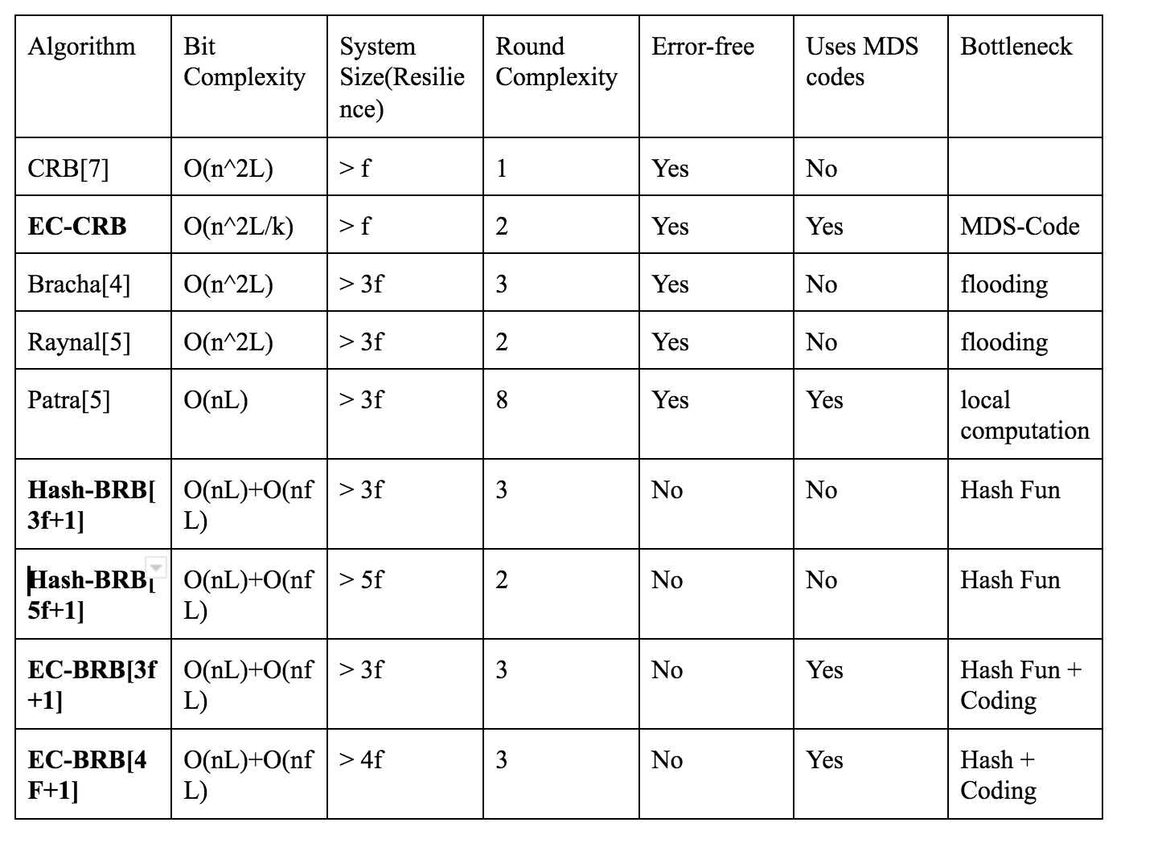
Theoretical Comparison of different algorithms
n = number of nodes in the system, L = size of the message

Slide 13
EC-CRB
Crash Failures Algorithm:
Servers can only stop but no byzantine behaviors (more common in practical network systems)
Heuristic idea:
Source sends unique codes to individual servers
Once the individual servers receive the codes, they broadcast the unique code they receive from the source node

Slide 14
EC-BRB: Source Broadcast (Round 1)
code1
ecnode(4,3)
Server 1
code2
code3
code4
Server 2
Server 3
Server 4

Slide 15
EC-BRB: Server Echo (Round 2)
Server 1
code2
code1
code1
code1
Server 2
code3
code2
Server 4
(Crash)
code3
code2
code3
Server 3

Slide 16
Hash-BRB[3f+1]
Byzantine failures algorithm:
Faulty Servers can have arbitrary faulty behavior
much more complicated than crash failure reliable broadcast

Slide 17
Hash-BRB[3f+1] Server Broadcast
In most of the asynchronous algorithm, a server just need to receive n - f of the same messages to make sure that all the non-faulty nodes will eventually agree on the same value.
Byzantine Server
m1
m1
m2
Server2
Server3
Server4

Slide 18
Hash-BRB[3f+1] Server Echo
send H(m1) to sever 2 and server 3
Byzantine Server
send H(m2) to server4
send H(m1)
receive H(m1) from byz server, serve2, and server 3
receive H(m2) from server 4
send H(m2)
receive H(m1) serve2, and server 3
receive H(m2) from byz server and server 4
send H(m1)
receive H(m1) from byz server, serve2, and server 3
receive H(m2) from server 4
Server2
Server3
Server4

Slide 19
Hash-BRB[3f+1] Server Request
Byzantine Server
Another threshold (f + 1), which is when one of the server see a message that it has not seen before for f + 1 times, then it will make a request of the data from those f + 1 senders
send data m1
send data m1
send request H(m1)
Server2
Server3
Server4

Slide 20
Why we build our benchmark tool
To our group knowledge, none of the prior algorithms have been benchmarked under practical settings
To our group knowledge, no open source benchmark tool for evaluating distributed reliable broadcast algorithms
Need automatic tool to start up arbitrary number of nodes.
Can tune network parameters to test the bottleneck of the algorithms:
Bandwidth constraint
CPU computational power
Network topology

Slide 21
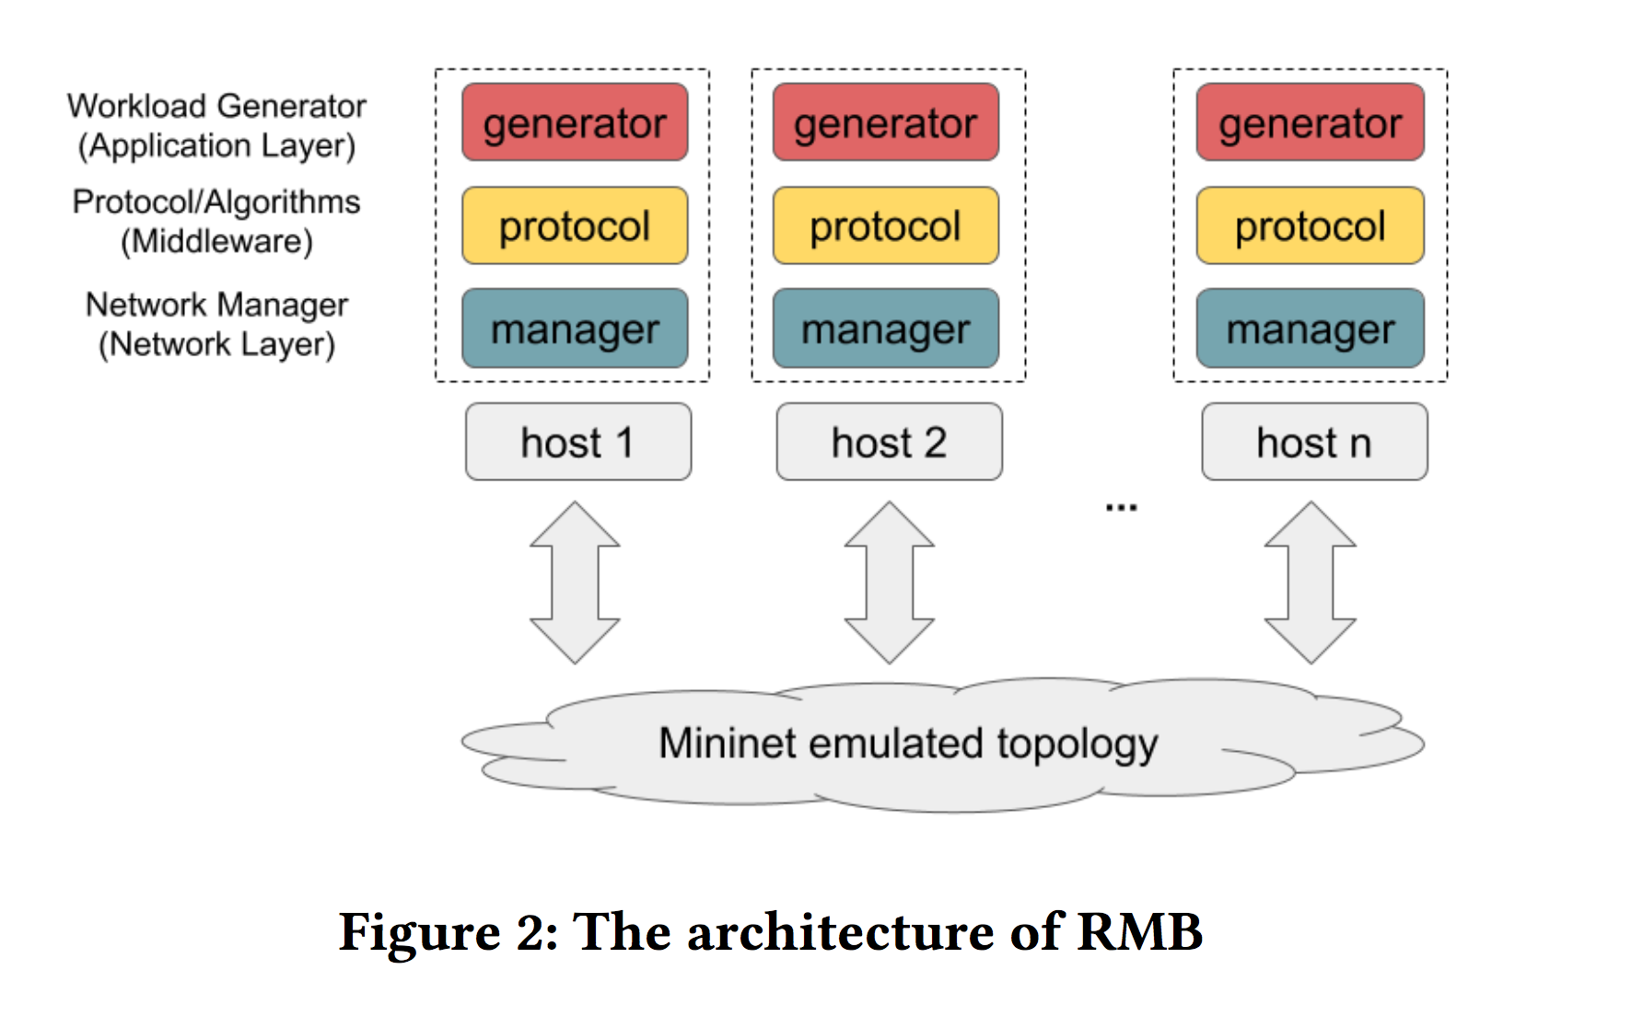
Benchmark tool (RMB)
Benefits using RMB:
User-Friendly:
Users only need to implementing their protocols without worrying about network communications and benchmarking.
User can easily define node byzantine behavior themselves if necessary.
Configurable network settings using Mininet:
Network Topology
Server CPU power
Network bandwidth and latency
link failure
...

Slide 22
Benchmark
Server used for benchmark:
RMB on a single virtual machine (google cloud platform instance) with
24vCPU
48 GB memory
By default, the RTT between individual nodes is between 0.06 ms and 0.08 ms.

Slide 23
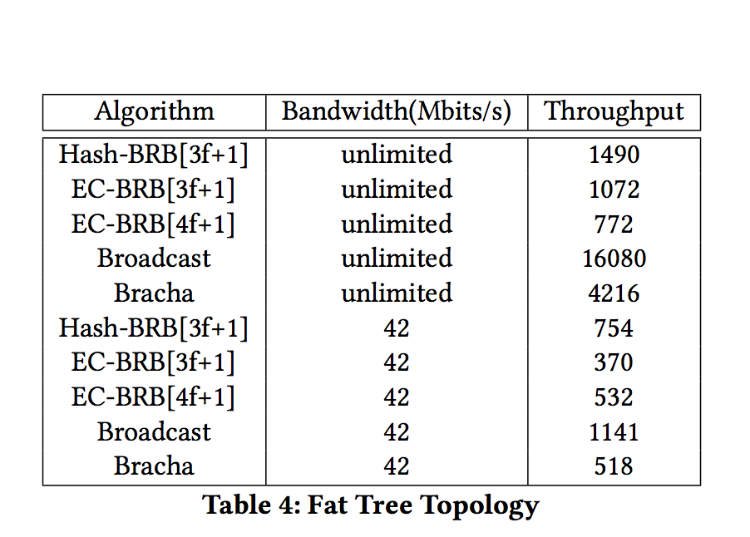
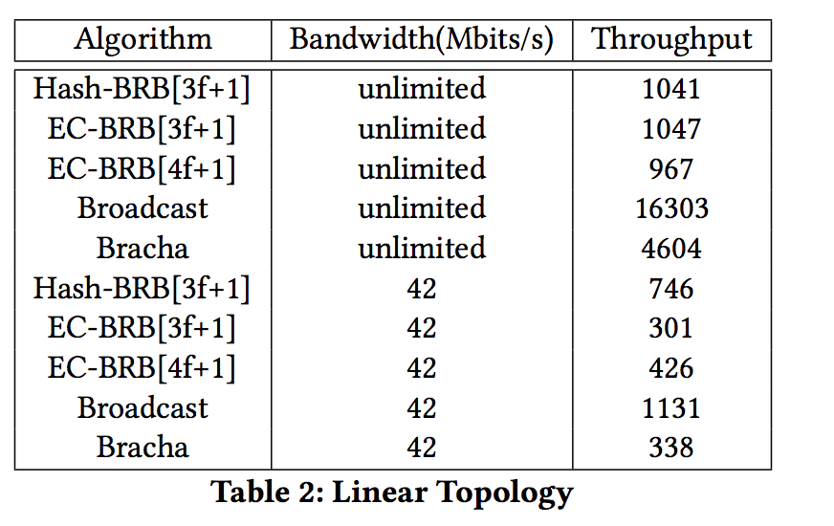
Benchmark Result 1: Different Network Topologies
Setup:
5 servers and 0 faulty servers under two different network topologies

Slide 24
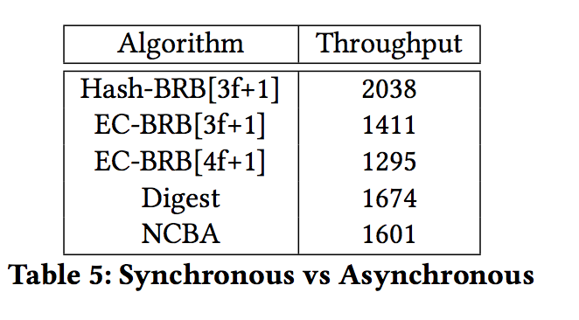
Benchmark Result 2: Sync vs Async
In general, Synchronous system serves a good base line.
Digest and NCBA
Benchmark Setup:
number of servers = 4,
message size 1024 bytes,
2000 messages broadcast.

Slide 25
Benchmark Result 3: Hash vs Erasure Code
Setup:
number of servers = 20, and 100 rounds of reliable broadcast
exp1: f = 4, source’s bandwidth limitation = 0.4 Mbits/s, message size = 1096 bytes.
exp2: f = 4, source’s bandwidth limitation = 4 Mbits/s, message size = 1096 bytes.
exp3: f = 1, source’s bandwidth limitation = 0.4 Mbits/s, message size = 1020 bytes
exp4: exp3: f = 1, source’s bandwidth limitation = 4 Mbits/s, message size = 1020 bytes.

Slide 26
Future Work
This work has been compiled into a paper and is currently under submission for conference.
Further refactor the codes, so users can understand the code much easily.
Design and implement more byzantine broadcast algorithms that considers other efficiency.

Slide 27
Special Recognition
Haochen (Roger) Pan: junior at Boston College
Helped setup Mininet
Design and writing proof for new reliable broadcast algorithms
Sapta Kumar: post-doc under Prof. Tseng:
Proofread the proof of the algorithms
Theoretical Analysis on individual algorithms
Prof. Lewis Tseng: supervisor of my Honor Thesis

Slide 28
Thanks

Slide 29
Reference
[1] Ittai Abraham, Yonatan Amit, and Danny Dolev. 2005. Optimal Resilience Asyn- chronous Approximate Agreement. In Principles of Distributed Systems, Teruo Higashino (Ed.). Springer Berlin Heidelberg, Berlin, Heidelberg, 229–239. [2] Hagit Attiya and Jennifer L. Welch. 2004. Distributed computing - fundamentals, simulations, and advanced topics (2. ed.). Wiley. [3] GabrielBracha.1987.AsynchronousByzantineAgreementProtocols.Inf.Comput. 75, 2 (Nov. 1987), 130–143. https://doi.org/10.1016/0890-5401(87)90054-X
[4] Damien Imbs and Michel Raynal. 2015. Simple and E cient Reliable Broad- cast in the Presence of Byzantine Processes. CoRR abs/1510.06882 (2015). arXiv:1510.06882 http://arxiv.org/abs/1510.06882
[5]Damien Imbs and Michel Raynal. 2016. Trading o t-resilience for e ciency in asynchronous Byzantine reliable broadcast. Parallel Processing Letters 26, 04 (2016), 1650017. [6] Arpita Patra and C. Pandu Rangan. 2011. Communication Optimal Multi-valued Asynchronous Byzantine Agreement with Optimal Resilience. In Information Theoretic Security - 5th International Conference, ICITS 2011, Amsterdam, The Netherlands,May21-24,2011.Proceedings.206–226. https://doi.org/10.1007/978-3- 642- 20728- 0_19
[7] Michel Raynal. 2018. Fault-Tolerant Message-Passing Distributed Systems - An Algorithmic Approach. Springer. mhttps://doi.org/10.1007/978-3-319-94141-7
[8] Mininet. http://mininet.org/

