Slide 1
Experience of Learning Blockchains
Xuheng Duan
April 30 2020
Advisor: Prof. Lewis Tseng

Slide 2
Goal
Share year-long experience in learning open source blockchain projects
Provide a thorough guideline and notes to future students
Help others to avoid mistakes I encountered

Slide 3
Timeline on the multiple projects/skills I worked on
Spring 2019: BLOCKBENCH, Google Cloud Platform
Summer 2019: Hyperledger Fabric, Docker
Fall 2019: IBM framework, Building a Network, Virtual Machine
Spring 2020: Hyperledger Caliper, Caliper++...

Slide 4
Open source Blockchain Systems
Hyperledger Fabric
Hyperledger Caliper
Caliper++
Mininet & Ethereum

Slide 5
Hyperledger Fabric - General
Private/permissioned blockchain system
Blockchain solution for enterprises
Has following properties:
  Participants are identifiable
  High transaction throughput performance
  Privacy and confidentiality of data between participants

Slide 6
Hyperledger Fabric - Structure
Peer/Node: Base unit of Hyperledger Fabric network. A peer will commit work
Organization: An organization could consist of multiple peers
Orderer: Orderer would manage the consensus process before data are sent to ledger
Channel: Provides secure communication places for involved organizations
Ledger: World State

Slide 7
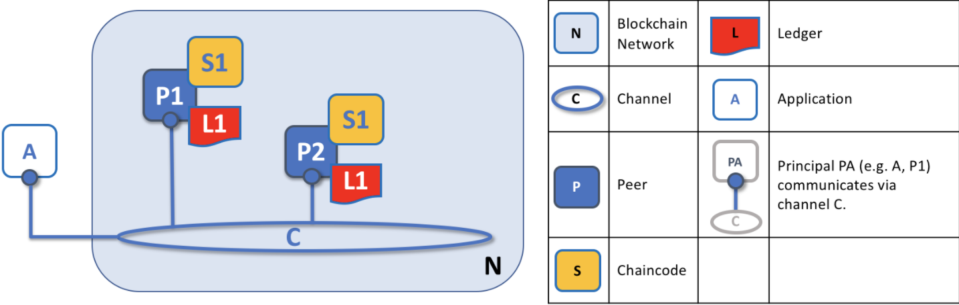
Hyperledger Fabric - Structure

Slide 8
Hyperledger Fabric - My Work
What’s the performance of Hyperledger Fabric?
Wrote application chaincode for the network
Used Hyperledger caliper to benchmark the Fabric network
Set up a customized Hyperledger Network locally
Distributed the hosts on several virtual machines

Slide 9
Hyperledger Fabric - Challenges
On multiple hosts:
Hyperledger Fabric contains numerous crypto materials(CA, MSP), which are hard to distribute on multiple hosts.
Build a cluster with virtual machines is a challenge. Setting up a multi-node cluster using Google Cloud Platform is time consuming and redundant. Probably Docker Swarm and Kubernetes could be better alternatives.
However, it could be avoid by good management, and good pre-research progress.

Slide 10
Hyperledger Fabric - Learning Path
Structure of Hyperledger Fabric
Official Build Your First Network example
Network knowledges:
IP Address, Ports
Bash knowledge - for writing scripts
Coding Language: Node
File path, configuration files(yaml)

Slide 11
Hyperledger Fabric - Learning Path
Try to manipulate the network, and adjust it into your version
Docker
Cluster Building (GCP, Docker Swarm, Kubernetes)
Network Construction
Hyperledger Application/Chaincode development
Benchmarking work

Slide 12
Hyperledger Fabric - Suggestions
Hyperledger Fabric has a clear macro structure. However, their components interact with each other in a complex way.
Adjust your learning curve constantly, and use your time wisely
  IBM framework was not the right thing to use
  Setting up a large cluster with raw virtual machines is unrealistic
ASK!

Slide 13
Hyperledger Caliper & Caliper++
official benchmark framework from hyperledger inc.
Caliper++ is the upgraded version by another development team, which included extra scripts to support distribute benchmarking
Hyperledger V0.3 also supports similar feature now.

Slide 14
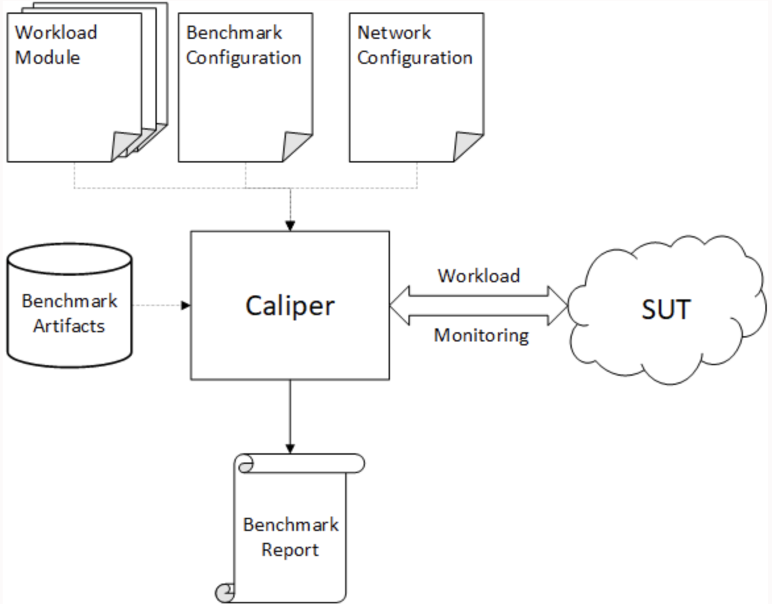
Hyperledger Caliper - Components
Workload Module
Benchmark Configuration
Network Configuration

Slide 15
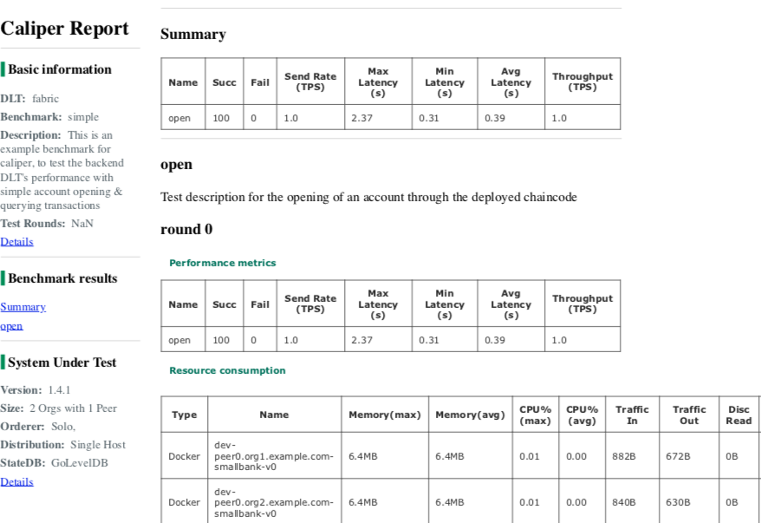
Hyperledger Caliper & Caliper++ - Results

Slide 16
Mininet & Ethereum
Benchmark Ethereum performances on the top of Mininet
Ethereum is another famous public blockchain project.
The mininet is a battle-test framework to mimic the real network
We picked several parameters on mininet:
  Bandwidth
  Network delay
  Jitter
  Network loss

Slide 17
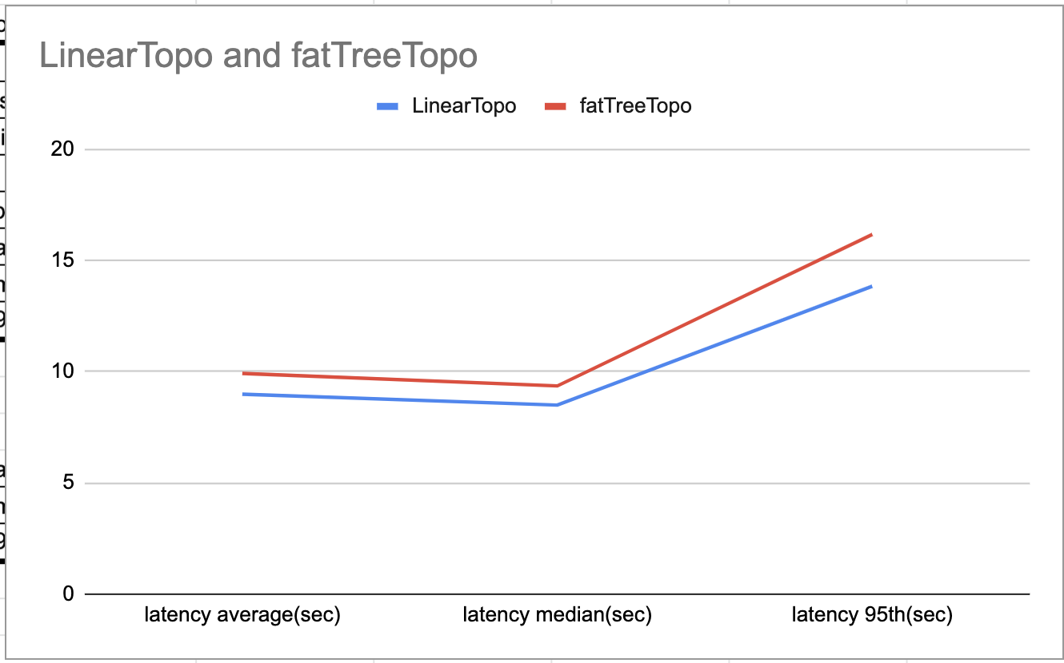
Mininet & Ethereum - Results

Slide 18
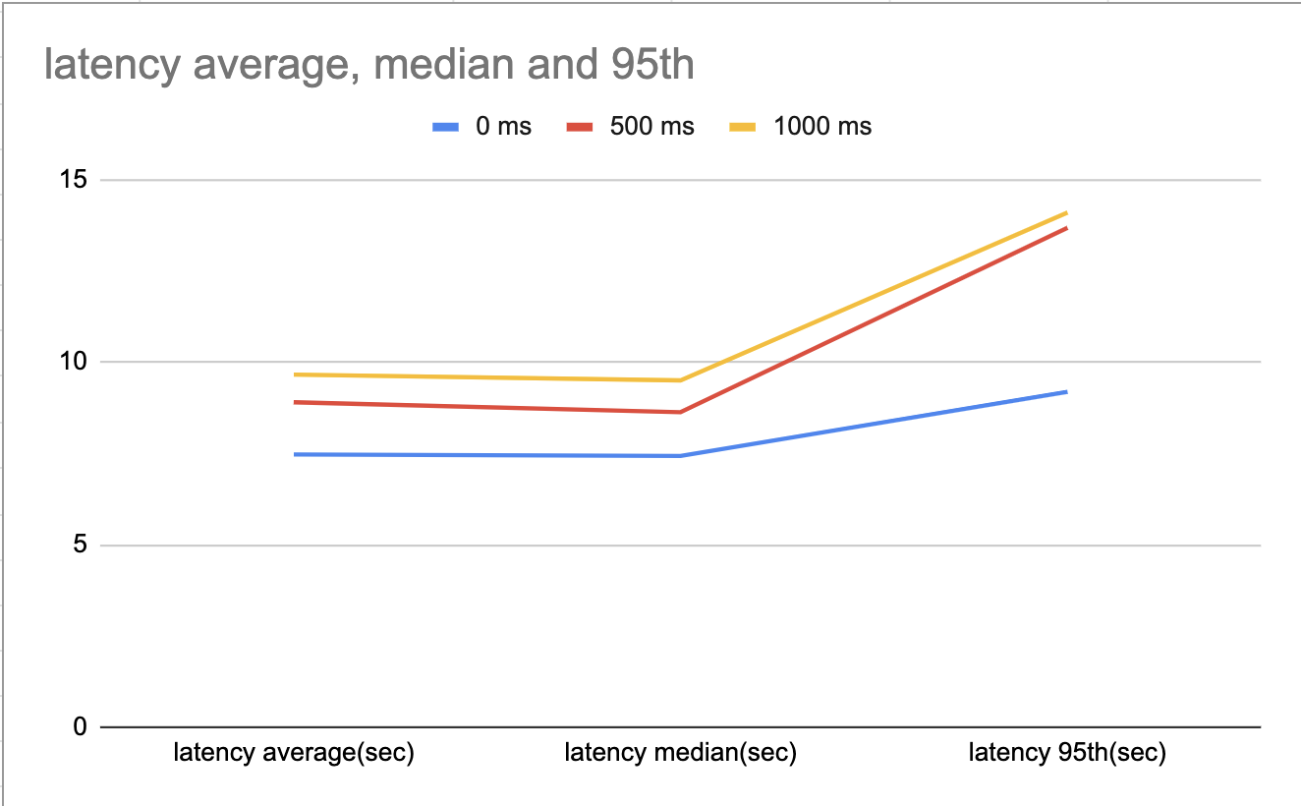
Mininet & Ethereum - Results

Slide 19
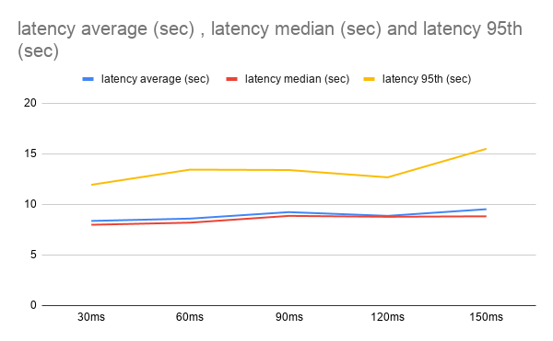
Mininet & Ethereum - Results

Slide 20
Ending
Check my thesis for more detailed information

Slide 21
Thank you for watching!

