Slide 1
Preparing for the CPA Exam
October 23, 2024
Slides available on the Accounting Department Homepage
James Connolly, PwC Capital Markets Advisory Group, 2024
Mary LaRovere, PwC Private Tax Group, 2024
Brenna McCaffrey, EY Audit, 2024
Reilly O’Shaughnessy, KPMG Financial Services Audit, 2024
Ashley Palmer, PwC Audit for Health Industries, 2024
Mike Ceglie, Becker Account Manager
Professor Dianne Feldman - Accounting Department

Slide 2
Agenda
Panelist Introductions
CPA and Exam General Information
Requirements to take the CPA Exam
The CPA Exam Process and Application
CPA Evolution Exam Format
When to Register?
When to Take the Exam and What Order?
Taking the Exam - Prometrics
Panelist Advice and Lessons Learned
Q&A

Slide 3
Introductions & Contact Information
James Connolly jtconnolly2020@gmail.com
Mary LaRovere marylarovere3@gmail.com
Brenna McCaffrey brenna.mccaffrey@ey.com
Reilly O’Shaughnessy reillyoshaugh@gmail.com
Ashley Palmer ashpalmer123@icloud.com
Michael Ceglie michael.ceglie@becker.com

Slide 4
CPA Exam: Players
The American Institute of Certified Public Accountants (AICPA): The AICPA is the largest national, professional organization for CPAs. The AICPA determines the content of the CPA examination, prepares the examination questions and determines the method of scoring.
State Boards of Accountancy: The CPA license is issued at the jurisdiction level. To become a CPA, you must be declared eligible for the examination, and subsequently licensed, by the Board of Accountancy in one of the 55 U.S. jurisdictions. The Constitution of the U.S. grants each state or territory the power to regulate the practice of the professions within that jurisdiction’s borders.
The National Association of State Boards of Accountancy (NASBA): The 55 U.S. and territorial Boards of Accountancy are the members of NASBA. NASBA exists to serve its members. NASBA takes on the role of a central clearinghouse where all jurisdictions submit information on eligible candidates. You may access the site here: NASBA
Prometric: Prometric is the only testing and assessment services for the Uniform CPA exam. Prometric operates test centers around the world. Prometric

Slide 5
CPA Exam
The Uniform Certified Public Accountant (CPA) Examination is developed by the AICPA with significant input and assistance by NASBA and state boards of accountancy. It is designed to assess the knowledge and skills entry-level CPAs need to practice public accountancy.
Effective January 10, 2024 the new version of the CPA exam was launched – this version is referred to as the CPA Evolution Model. CPA Evolution includes 3 Core Sections and 3 Discipline Sections. CPA candidates must pass all three Core Sections and one Discipline Section of their choice.
Core Sections (pass all three):
  Financial Accounting & Reporting (FAR) – 4 hours
  Taxation and Regulation (Tax & Business Law) (REG) – 4 hours
  Auditing & Attestation (AUD) – 4 hours
Discipline Sections (pass one section of your choice):
  Business Analysis and Reporting (BAR) – 4 hours
  Tax Compliance and Planning (TCP) – 4 hours
  Information Systems and Controls (ISC) – 4 hours

Slide 6
CPA Exam: General Information
The requirements to take the CPA exam are a subset of the requirements to be licensed as a CPA and vary by state (make sure you know the requirements for the state you will be licensed in).
You can take the 4 different parts in any order, however, it is highly recommended you take BAR immediately following FAR; TCP immediately following REG or ISC immediately following AUD.
75 is the passing grade and is scaled (not curved).
You may schedule your examination at any Prometric site in any of the jurisdictions. You do not have to sit in the same state where you applied to be licensed.
Beginning in 2025, there will be continuous testing for the core sections. Discipline sections will continue to have limited testing windows.
Once you pass one part of the exam, you have 18 months to complete the remaining parts. Otherwise, you will need to retake the part(s) that you passed that is (are) over 18 months old. Note: As a result of CPA Evolution, most states have increased this window to 30 months. MA & NY are 30 months.

Slide 7
Sitting for the CPA: MA requirements
Be at least 18 years old.
Completion of at least 120 semester credit hours and bachelor’s degree. Note: AP credits will not be included on your transcript until you graduate.
MA candidates may apply for OR take an exam section 90 days before their official graduation date (and 120 credit completion) by providing a Certificate of Enrollment and then providing a Certified final transcript within 90 days of taking the exam. Sara Nunziata in Fulton 315 can notarize your form. Note: the forms can found on the table outside the accounting department, Fulton 520.
Taken at least 21 Accounting credit hours including coverage in Financial accounting, Management (Cost) accounting, Taxation and Auditing.
Taken at least 9 business credit hours with coverage in Finance, Business Law & Information Systems (Coding meets this requirement).

Slide 8
Sitting for the CPA: NY requirements
Complete at least 120 semester credit hours. Note: AP credits will not be included on your transcript until you graduate.
Unlike in MA, candidates must have completed 120 credit hours PRIOR to applying for the exam.
Complete a course in each of the following: financial accounting, cost or management accounting, taxation, audit and attestation.

Slide 9
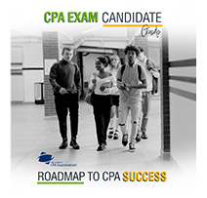
CPA Exam Process
Visit the NASBA site.
Obtain and Read the Candidates Bulletin
Apply for an Education Evaluation
After you are found eligible, complete an Exam Section Application – name on application MUST match the name on the ID you will use the day of the exam
Study/Prepare for Exam
Receive Your Notice to Schedule (NTS) – good for 6 months in most states
Schedule Your Examination
Take Your Examination
Receive Your Score Reports

Slide 10
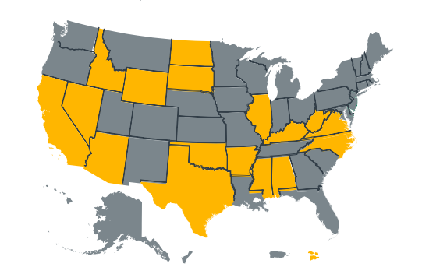

CPA Exam Application
If you are applying to a state highlighted in gray: apply online through NASBA’s CPA Examination Online Application System. CPA Online
If you are applying to a state highlighted in yellow: apply directly to the State Board of Accountancy. State Boards

Slide 11
CPA Exam: Application Materials
An official transcript from each school listed on your application. Transcripts must be sent directly from your school(s) Student Services to CPA Examination Services. etranscript@nasba.org.
  Note: Courses not taken at BC will NOT be on your BC transcript (you will send separate transcripts from these schools).
  The AP courses which BC accepted will appear on your BC transcript after you graduate. Be sure to respond to the email from Professor Ed Taylor at the end of your senior year to “flip” you AP credits upon graduation.
Application and Exam Fees:
  Application Fee for First Time Candidates: @ $195 but varies state to state ($100 – 200)
  Registration fee for each exam @ $400. You may register for multiple sections of the exam at the same time, you will receive a separate Notice to Schedule (NTS) for each section which is good for 6 months.

Slide 12
CPA Evolution Exams
The New CPA Evolution Exam
CORE:
DISCIPLINES:
AUD
Auditing & Attestation
ISC
Information Systems & Controls
FAR
Financial Accounting & Reporting
BAR
Business Analysis
& Reporting
REG
Regulation
TCP
Tax Compliance
& Planning
Must pass all 3 sections.
Must pass 1 section.

Slide 13
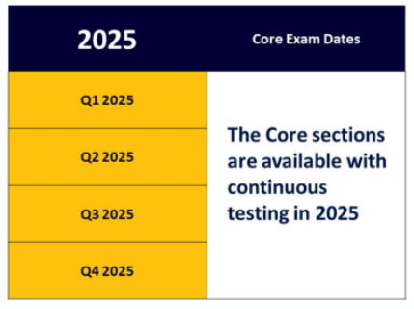
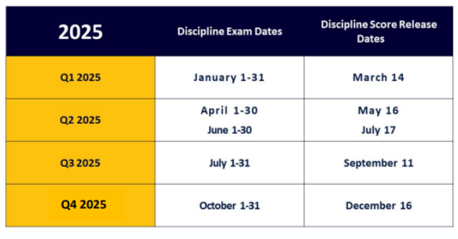
2025 CPA Exam Schedule

Slide 14
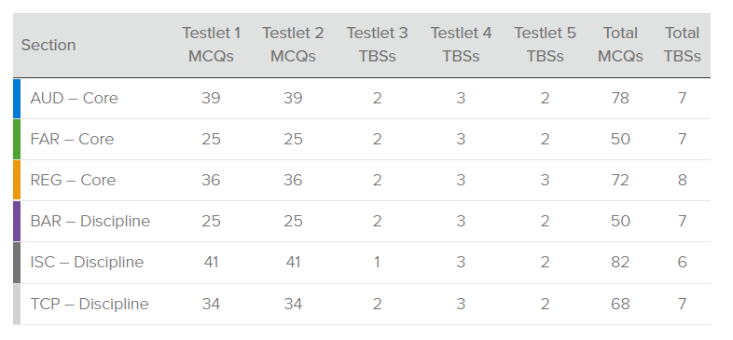
CPA Exam Format

Slide 15

Becker
Exam structure | Auditing & Attestation (AUD)
 |  |  |  | Skill level
Content covered |  |  | Scoring weight | Remembering & understanding | Application | Analysis | Evaluation
I | Ethics, Professional Responsibilities and General Principles |  | 15-25% | . | .
II | Assessing Risk and Developing a Planned Response |  | 25-35% | . | . | . | .
III | Performing Further Procedures and Obtaining Evidence |  | 30-40% | . | . | . | .
IV | Forming Conclusions and Reporting |  | 10-20% | . | .
5-15%
30-40%
15-25%
Question type | #
Multiple-choice Questions (MCQ) | 78
Task-based Simulations (TBS) | 7
Expected study time
30-40%
80-100
Evaluation (TBS) 5-15%
Analysis (TBS) 15-25%
Application (MCQ, TBS) 30-40%
Remembering & Understanding (MCQ) 30-40%
HOURS
With a foundation of auditing and advanced auditing classes
Notes:
In order to begin your study, visit www.AICPA.org/CPAExam and view the CPA Exam Blueprints to learn about the specific topics tested in each Exam section.
Successful CPA candidates must have a thorough academic understanding of exam material, as well as the ability to apply their knowledge instinctively. Becker’s CPA Exam Review course is comprehensive and personalized to better prepare students for the exam.
Let’s take a look at an overview of each section. We begin with Auditing and Attestation, or Audit.
Auditing encompasses the entire audit process, plus other services including compilations, reviews and attestation engagements, and the AICPA Code of Professional Conduct.
The exam is 4 Hours and contains 78 multiple-choice questions and seven task-based simulations.

Slide 16
Becker
Exam structure | Financial Accounting & Reporting (FAR)
 |  |  |  | Skill level
Content covered |  |  | Scoring weight | Remembering & understanding | Application | Analysis | Evaluation
I | Financial Reporting |  | 30-40% | . | . | .
II | Select Balance Sheet Accounts |  | 30-40% | . | . | .
III | Select Transactions |  | 25-35% | . | . | .
5-15%
35-45%
Question type | #
Multiple-choice Questions (MCQ) | 50
Task-based Simulations (TBS) | 7
45-55%
Expected study time
80-100
Analysis (TBS) 35 - 45%
Application (MCQ, TBS) 45 - 55%
Remembering & Understanding (MCQ) 5 - 15%
HOURS
With a foundation of intermediate and advanced accounting classes
Notes:
Next is the Financial Accounting and Reporting, or FAR.
Financial encompasses the largest volume of information, which can make it challenging.
However, most students take several classes relevant to this section of the exam during their degree program, so it is also likely to be relatively fresh.
Candidates should expect some questions focused on key differences between financial statements prepared on a U.S. GAAP basis versus those prepared on an IFRS® basis.
The exam is 4 Hours and contains 50 multiple-choice questions and seven task-based simulations.

Slide 17
Becker
Exam structure | Taxation and Regulation (REG)
 |  |  |  | Skill level
Content covered |  |  | Scoring weight | Remembering & understanding | Application | Analysis | Evaluation
I | Ethics, Professional Responsibilities and Federal Tax Procedures |  | 10-20% | . | .
II | Business Law |  | 15-25% | . | .
III | Federal Taxation of Property Transactions |  | 5-15% |  | . | .
IV | Federal Taxation of Individuals |  | 22-32% | . | . | .
V | Federal Taxation of Entities (including tax preparation) |  | 23-33% | . | . | .
35-45%
25-35%
Expected study time
25-35%
Question type | #
Multiple-choice Questions (MCQ) | 72
Task-based Simulations (TBS) | 8
80-100
Analysis (TBS) 25-35%
Application (MCQ, TBS) 35-45%
Remembering & Understanding (MCQ) 25-35%
HOURS
With a foundation of federal taxation and business law
Notes:
Lastly, Regulation, or REG.
The exam is 4 Hours and contains 72 multiple-choice questions and eight task-based simulations.
Regulation is the combination of federal taxation and business law, including ethics and professional responsibilities.
Students who are familiar with tax, whether personal, partnership or corporate, should be comfortable with the Regulation materials.
The areas covered within the business law portions are straight out of most university business law core classes.
If you will or are working in a tax practice, Regulation might be a place to start to gain confidence.

Slide 18
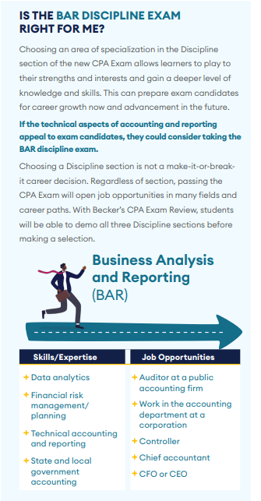
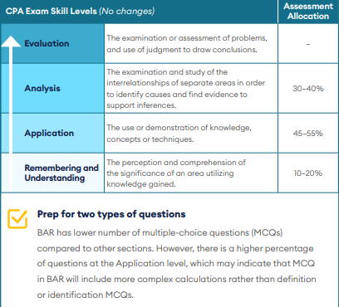
Becker
Exam structure | Business Analysis & Reporting (BAR)
 |  |  |  | Skill level
Content covered |  |  | Scoring weight | Remembering & understanding | Application | Analysis | Evaluation
I | Business Analysis |  | 40-50% | . | . | .
II | Technical Accounting and Reporting |  | 35-45% | . | . | .
III | State and Local Governments |  | 10-20% | . | .
Question type | #
Multiple-choice Questions (MCQ) | 50
Task-based Simulations (TBS) | 7
Expected study time
100-120
HOURS
With a foundation of economics…
Notes:
First Let’s look at Business Analysis & Reporting or BAR.
The exam is 4 Hours and contains 50 multiple-choice questions and seven task-based simulations.
Analyzing financial statements and information with a focus on the CPA’s role in comparing historical results to budgets and forecasts • Deriving the impact of transactions, events (actual and proposed), and market conditions on performance measures • Comparing investment alternatives • Technical accounting and reporting requirements under the FASB and SEC that are applicable to forprofit business entities and higher order skills related to revenue recognition and lease accounting • Financial accounting and reporting requirements under GASB that are applicable to state and local government entities • Revenue recognition • Lease accounting • Non-financial measures of performance • Managerial and cost accounting concepts • Variance analysis • Budgeting, forecasting and projection techniques • Factors that influence an entity’s capital structure, including leverage, cost of capital, liquidity and loan covenants • Financial valuation decision models used to compare investment alternatives • COSO Enterprise Risk Management Framework • Effect of changes in economic conditions and market influences on an entity’s business

Slide 19
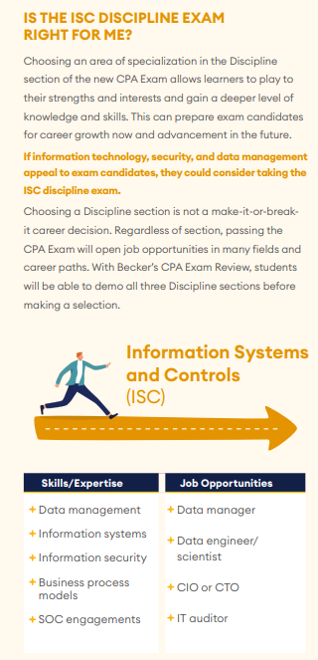
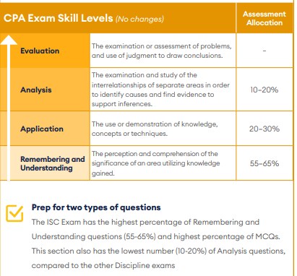
Becker
Exam structure | Information Systems & Controls (ISC)
 |  |  |  | Skill level
Content covered |  |  | Scoring weight | Remembering & understanding | Application | Analysis | Evaluation
I | Information Systems and Data Management |  | 35-45% | . | . | .
II | Security, Confidentiality and Privacy |  | 35-45% | . | . | .
III | Considerations for System and Organization Controls (SOC) Engagements |  | 15-25% | . | .
Question type | #
Multiple-choice Questions (MCQ) | 82
Task-based Simulations (TBS) | 6
Expected study time
60-80
HOURS
With a foundation of information system…
Notes:
Now, let’s look at Information Systems & Controls or ISC.
The exam is 4 Hours and contains 82 multiple-choice questions and six task-based simulations.
Information technology (IT) audit and advisory services
• Data management, including data collection, storage and usage through the data life cycle
• SOC engagements, with a focus on: the use of the description criteria for a service organization’s system and trust services criteria for security, availability, processing integrity, confidentiality and privacy in planning, performing, and reporting in a SOC 2® engagement
• Planning, certain procedures (excluding the testing of internal controls over financial reporting), and reporting on a SOC 1® engagement
• Business processes and internal controls
• IT architecture components and the use of cloud-based models for IT infrastructure, platforms, and services
• System availability and IT change management

Slide 20
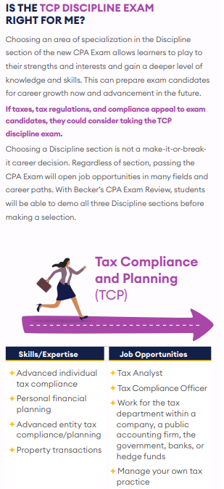
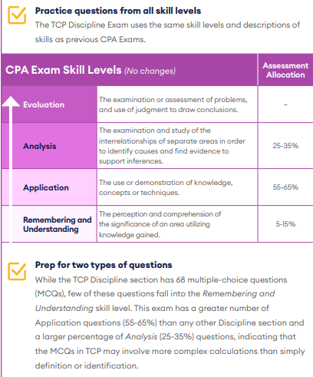
Becker
Exam structure | Tax Compliance & Planning (TCP)
 |  |  |  | Skill level
Content covered |  |  | Scoring weight | Remembering & understanding | Application | Analysis | Evaluation
I | Tax Compliance and Planning for Individuals and Personal Financial Planning |  | 30-40% | . | . | .
II | Entity Tax Compliance |  | 30-40% | . | . | .
III | Entity Tax Planning |  | 10-20% |  | . | .
IV | Property Transactions (disposition of assets) |  | 10-20% | . | . | .
Question type | #
Multiple-choice Questions (MCQ) | 68
Task-based Simulations (TBS) | 7
Expected study time
60-80
HOURS
With a foundation of tax…
Notes:
Now, let’s look at Tax Compliance & Planning or TCP.
The exam is 4 Hours and contains 68 multiple-choice questions and seven task-based simulations.
TCP tests the knowledge and skills a CPA must demonstrate in:
U.S. federal tax compliance for individuals and entities with a focus on nonroutine and higher complexity transactions, U.S. federal tax planning for individuals and entities, and personal financial planning
• Assessment of federal tax compliance with an emphasis on the CPA’s role in both the preparation and review of tax returns.
• Assessment of federal tax planning with a focus on the CPA’s role in determining the tax implications of proposed transactions, available tax alternatives, or business structures
• Assessment of personal financial planning with a concentration on planning strategies and opportunities that the CPA typically identifies in connection with the preparation and review of individual tax returns
• Consolidated C corporation tax returns
• International tax issues

Slide 21
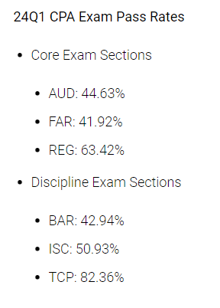
What discipline should I take?
The BC Accounting and Carroll School core curriculum aligns best with:
BAR (@90% of content coverage)
TCP (@80% of content coverage)

Slide 22
Examination Blueprints
In January 2023, the American Institute of CPAs (AICPA) released the updated Uniform CPA Examination® Blueprints, the official document of content eligible for assessment on the Exam starting in January 2024. The Blueprints are based on the knowledge and skills required of a newly licensed CPA to meet the demands of firms, employers and clients.
According to the AICPA, today’s CPAs need deeper skill sets, more competencies and greater knowledge of emerging technologies and their impact on tax, accounting and audit. Therefore, to prepare CPA candidates and accounting students for this new environment, the licensure model is evolving through the AICPA and National Association of State Boards of Accountancy (NASBA) joint CPA Evolution initiative.

Slide 23
When to register?
When to register (BC Seniors/MSAs):
  MA Candidates/States Accepting Certificates of Enrollment: Apply in late February to mid-March (6 month window for NTS) by completing Certificate of Enrollment, sooner if you have 120 credits by year-end (not including APs on your BC transcript).
  NY Candidates/States Not Accepting Certificates of Enrollment: Apply in late February to mid to late March if you have 120 credits (not including APs on your BC transcript) as of the beginning of Spring semester. Otherwise, must wait until graduation.

Slide 24
When to take the exam?
Take the exam as soon as possible --- while you’re still in a “student or test-taking” frame of mind. You are significantly more likely to pass the exam if you sit within one year of graduation. The longer your test-taking skills to diminish. You may also run into your start date for work, you want minimize testing while you are working full-time!
What classes will you be taking just before or during the review? Take that part of the exam that is most consistent with the classes you’re taking (senior spring).
Take the related discipline immediately following the core section – you will get more out of your studying and be in that “mode”.
Should I take a section senior spring?
Remember, you only have 30/18 months from the time you pass the first part to get the rest of the parts completed.

Slide 25
Exam Order and Timing
  Study mid-May to mid-June for FAR or REG (BC curriculum has the most coverage in these areas) – 4 to 5 weeks FT. Take exam late June.
  Study rest of June and early July for BAR or TCP – 4 to 5 weeks FT. Take BAR or TCP during 3rd Discipline window July 1 – July 31.
  Study in late July/August for FAR/REG or AUD. 4 to 5 weeks FT. Take exam in late August or early September.
  Study in Late Aug/Sept for last part. 4 to 5 weeks FT. Take exam in late September or early October.
  ALTERNATIVELY….

Slide 26
Exam Order and Timing
  Study mid-May to mid-June for FAR or REG (BC curriculum has the most coverage in these areas) – 4 to 5 weeks FT. Take exam late June.
  Study rest of June and July for AUD – 4 to 5 weeks FT. Take AUD by end of July.
  Study in late July/August for FAR or REG. 4 to 5 weeks FT. Take exam in late August or early September.
  Study in Late Aug/Sept for BAR or TCP 4 to 5 weeks FT. Take BAR or TCP during 4th Discipline window October 1-31 .
  What if I fail a section?

Slide 27
Taking the Exam - Prometrics
  Arrive Early: You must arrive at the test center at least 30 minutes before the scheduled appointment time for your examination to avoid forfeiting all fees for the examination section. This allows time to sign in, undergo scanning via handheld metal detector wand, have your digital photograph and fingerprint taken, review the security and test center policies and be seated at your workstation
  Notice to Schedule: You must take your notice to schedule to the testing center. Your NTS includes the Launch Code that you will enter on the computer as a part of the login process. Be sure to take the correct NTS with you. You will not be admitted into the test center without the correct NTS and you will forfeit all examination fees for that section.
  Personal Identification: The Uniform CPA Examination employs very strict security measures. One level of security involves your identification. The same form of your name must appear on your application, NTS and on the identification you present at the test center. Do not change the spelling and do not change the order of your name on applications or when making appointments. If your name is different from your identifications at check-in, you will not be permitted to test.

Slide 28
Panelists – Lessons Learned
James Connolly
Mary LaRovere
Brenna McCaffrey
Reilly O’Shaughnessy
Ashley Palmer

Slide 29
Questions???

